Slide 1
TEKNOLOGI INTEGRASI SISTEM
Pengantar Teknologi Integrasi Sistem
Andri Santoso, S.Kom., M.Sc.

Slide 2
Saat ini, seluruh proses bisnis sudah terdigitalisasi.
Sebagian besar perusahaan memiliki kebutuhan digital yang jauh lebih besar daripada ekpektasi awal.
Mereka membutuhkan berbagai macam produk hardware dan software untuk memenuhi kebutuhan digitalisasi tersebut.
Produk-produk tersebut didesain secara terpisah, tetapi ada kebutuhan untuk membuat semua produk tersebut bisa bekerja sama untuk mendapatkan sebuah proses bisnis digital yang lebih efisien.

Slide 3
Definisi
Integrasi Sistem adalah proses menghubungkan atau menggabungkan berbagai macam komponen menjadi sebuah elemen tunggal yang dapat melakukan semua fungsi tertentu.
Koneksi dari berbagai macam fitur melalui integrasi sistem menjadikan sebuah sistem utama bisa menjalankan fungsionalitas khusus yang dibutuhkan oleh sebuah perusahaan.

Slide 4
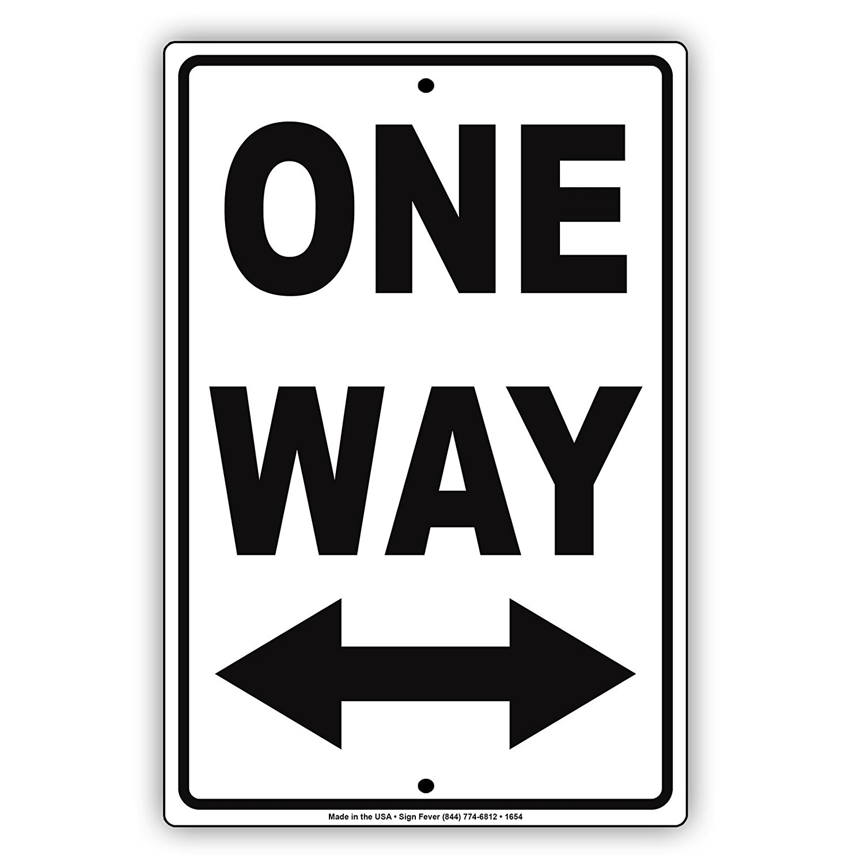
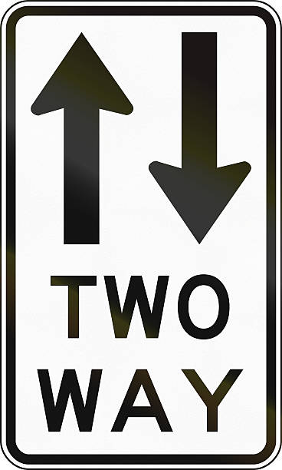
Integrasi sistem bisa dalam bentuk…
mono-directional (one-way)
bi-directional (both ways).
Secara singkatnya, data ataupun fungsionalitas harus bisa berjalan dengan lancar antar fitur/sistem yang diintegrasikan sehingga mereka bisa berkomunikasi secara optimal.

Slide 5
Tantangan pada Integrasi Sistem
Dulu, integrasi sistem seringnya adalah sebuah pekerjaan kompleks yang sangat sulit dan melelahkan untuk dikerjakan.
Sistem ataupun aplikasi dari berbagai macam vendor/provider membutuhkan solusi integrasi yang custom-coded dan point-to-point
Solusi ini terbukti tidak fleksible, rapuh, dan membutuhkan maintenance secara terus menerus.
Setiap ada software update ataupun perubahan pada proses bisnis bisa merusak seluruh integrasi sistem.
Loncat ke jaman sekarang, sudah banyak solusi integrasi yang baik, robust dan canggih; yang memungkinkan teknologi-teknologi baru seperti cloud, big-data, dan IoT berkomunikasi dengan efektif dan efisien satu sama lain.

Slide 6
Kenapa sistem harus diintegrasikan?
Sebuah proses baru mungkin saja ditambahkan atau menjadi lebih kompleks ketika sebuah perusahaan berkembang.
Akhirnya, berbagai macam fungsi bisnis bisa berada pada beberapa sistem yang terpisah dimana sistem tersebut tidak berkomunikasi ataupun berbagi data satu sama lain. Hasilnya: Proses menjadi tidak efisien dan mahal
Sebaliknya, dengan mengintegrasikan proses bisnis pada sebuah platform tunggal, semua fungsi pada rantai proses bisnis bisa digabungkan menjadi satu sistem sehingga akan meningkatkan produktifitas dan kualitas operasional. Hal tersebut dikarenakan semakin lancarnya aliran informasi.

Slide 7
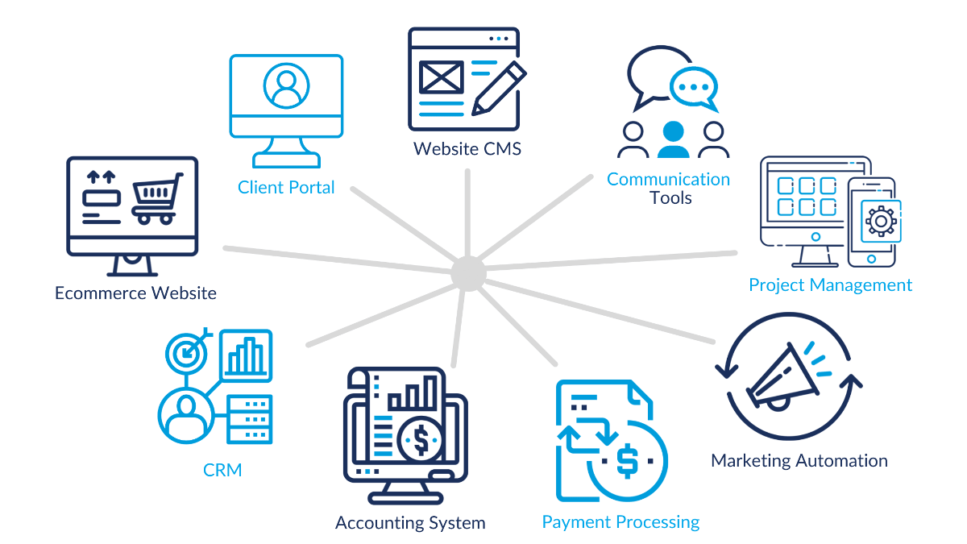
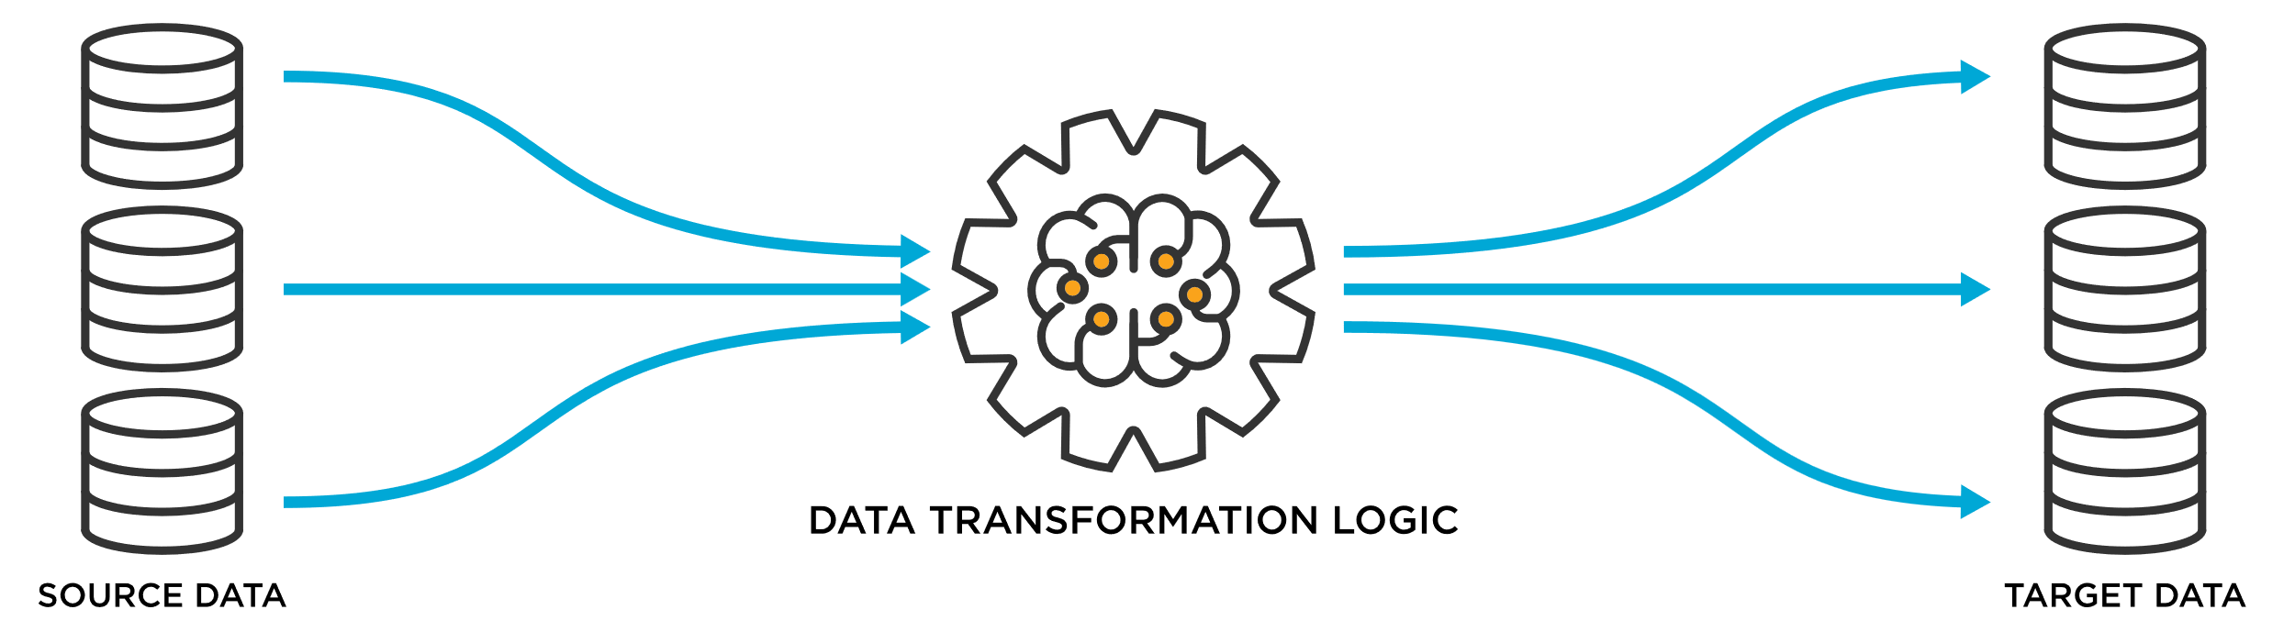
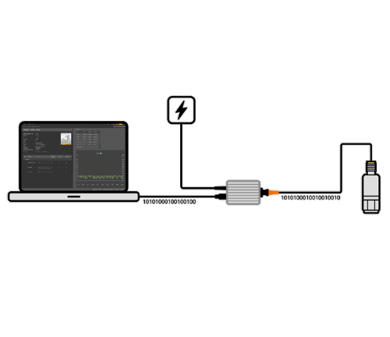
Jenis Integrasi Sistem
Integrasi Data
Integrasi Software to Software
Integrasi Software to Hardware

Slide 8
INTEGRASI SOFTWARE TO SOFTWARE

Slide 9
Definisi Software Integration
Software integration is the process of connecting various types of software sub-systems to unify data collection. It is used to solve the problem of isolated data.
The integration process can be streamlined with the use of modern integration tools.
Before initiating system integration, business teams must consider which of their systems need to be integrated, what tool aligns with their needs, and which data sources could benefit from integration.

Slide 10
Why?
Organizations will conduct software integration for a variety of reasons:
Businesses may need to merge different systems together
Business may want to transition from legacy solutions to modern applications.
Companies will also integrate software solutions to boost their overall functionalities.

Slide 11
How to get started?
To get started, you’ll need to find the answers to these questions:
What type of software will you integrate?
Apakah menggunakan In-house software, Software as a Service (SaaS)?
Perusahaan kecil biasanya langsung menjatuhkan pilihan ke SaaS
Baik perusahaan kecil ataupun besar, jika mereka menggunakan in-house software, maka dibutuhkan tim engineer untuk membangun sebuah software untuk proses integrasi. Jika merasa terlalu kompleks dan tidak ada sumber daya, bisa menggunakan IPaaS (Integration Platform as a Service) https://www.gartner.com/reviews/market/enterprise-integration-platform-as-a-service
Aplikasi berbasis cloud (yaitu SaaS) menjadikan proses integrasi menjadi lebih mudah. Sebagian besar dari mereka menyediakan API umum yang bisa diakses secara publik.
Which integration software do you need?
Native/in-app integration?
Which type of data needs integration?
When we talk about data, we can be referring to numbers, people, companies, products ... you name it! To set up an integration, you need to identify which part of your two or more databases make sense to combine.

Slide 12
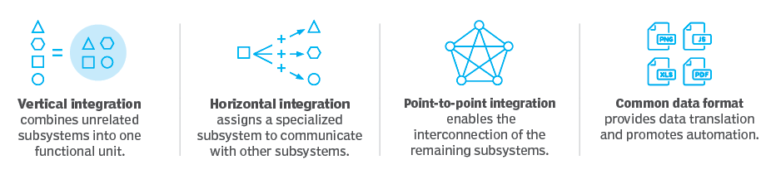
Software integration types
Star Integration
Horizontal Integration
Vertical Integration
Common data format integration

Slide 13
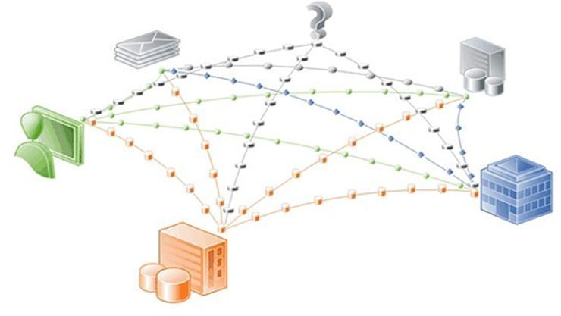
Star Integration
Star integration is the process of developing connections within all software subsystems.
Its name comes from the fact that when all the systems are interconnected, its diagram would look like a star.

Slide 14
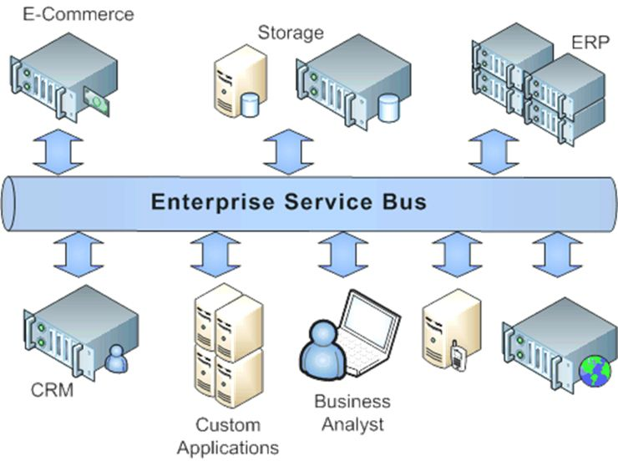
Horizontal Integration
A horizontal integration, also known as the Enterprise Service Bus, is the method of establishing a system for communication.
Horizontal integrations will reduce the number of links for each subsystem.
This approach will allow for flexibility, in which teams can add, remove, or adjust a system without interrupting the rest of the components.

Slide 15
Vertical Integration
In contrast to horizontal integration, vertical integration is a short-term solution and is considered a fast and inexpensive option for software unification.
The company must develop functional entities for their software systems and vertically sync them.
Pros:
Better control over business processes
Maximized competitiveness
For retailers, it can also help streamline supply chain management, improve vendor communication, and reduce operating costs
Cons:
vertical integrations will create a silo to scale the software. This means that information will not be properly shared and will be isolated in each system.

Slide 16
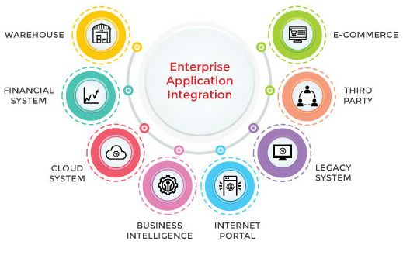
4. Common data format integration
A common data format is an approach to software integration that allows businesses to avoid the use of an adapter when converting or transporting data.
For this method to be effective, the data format from one system must be accepted by the other system.
EAI (Enterprise Application Integration) systems usually, contain a data transformation service that enables the conversion between specific and common application formats.
→ the adapter converts data from the application’s format to common and applies semantic transformations to this.

Slide 17
Contoh software integration
Here are some examples of software integration:
Integrating your website with social media platforms like Facebook and Twitter so users can share content from your site.
Integrating your accounting system with an e-commerce platform like Magento or Shopify so orders can be automatically processed when a customer places them online.
Integrating your CRM system with an email marketing platform like MailChimp so marketing emails can be sent automatically when new leads sign up for your service.
Integrating Google Analytics into WordPress so you can track visitor activity on your website without switching between tools.

Slide 18
INTEGRASI SOFTWARE TO HARDWARE

Slide 19
Software to Hardware Example
hardware+software Integration: IoT (Internet of Things)
By means of low-cost computing, the cloud, big data, analytics, and mobile technologies, physical things can share and collect data with minimal human intervention

Slide 20
What technologies have made IoT possible?
Access to low-cost, low-power sensor technology.
Connectivity
Cloud computing platforms
Machine learning and analytics
Conversational artificial intelligence (AI), like Alexa, Siri, Bixby

Slide 21
What is industrial IoT?
Industrial IoT (IIoT) refers to the application of IoT technology in industrial settings, especially with respect to instrumentation and control of sensors and devices that engage cloud technologies.
IIoT is sometimes called the fourth wave of the industrial revolution, or Industry 4.0. The following are some common uses for IIoT:
Smart manufacturing
Connected assets and preventive and predictive maintenance
Smart power grids
Smart cities
Connected logistics
Smart digital supply chains

Slide 22
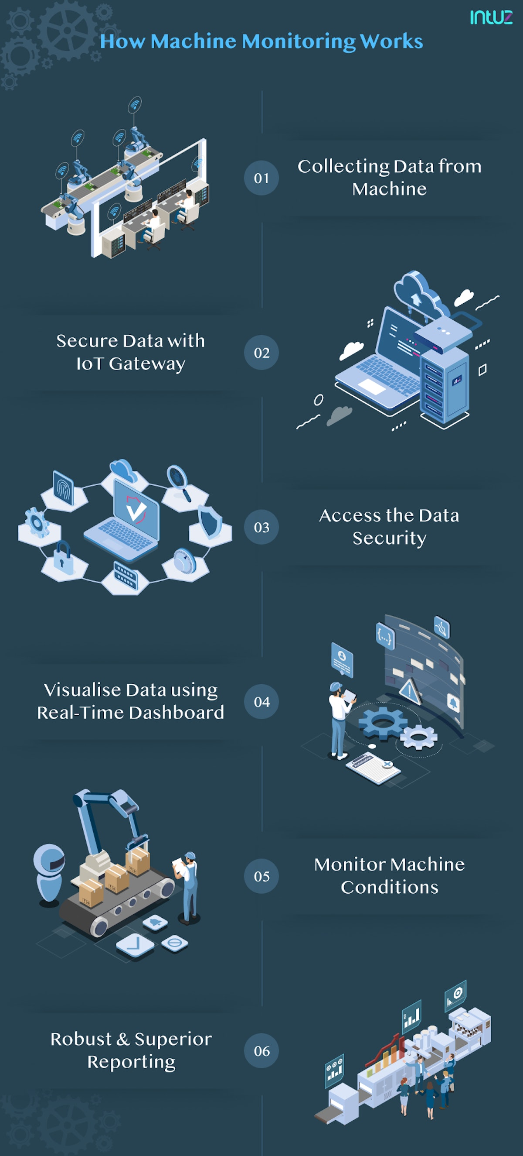
What industries can benefit from IoT?
Manufacturing
The main industrial goal of machine monitoring is to maximize profits, enhance productivity levels of those working on the shop floors, and minimize costs - without compromising the product or service quality

Slide 23
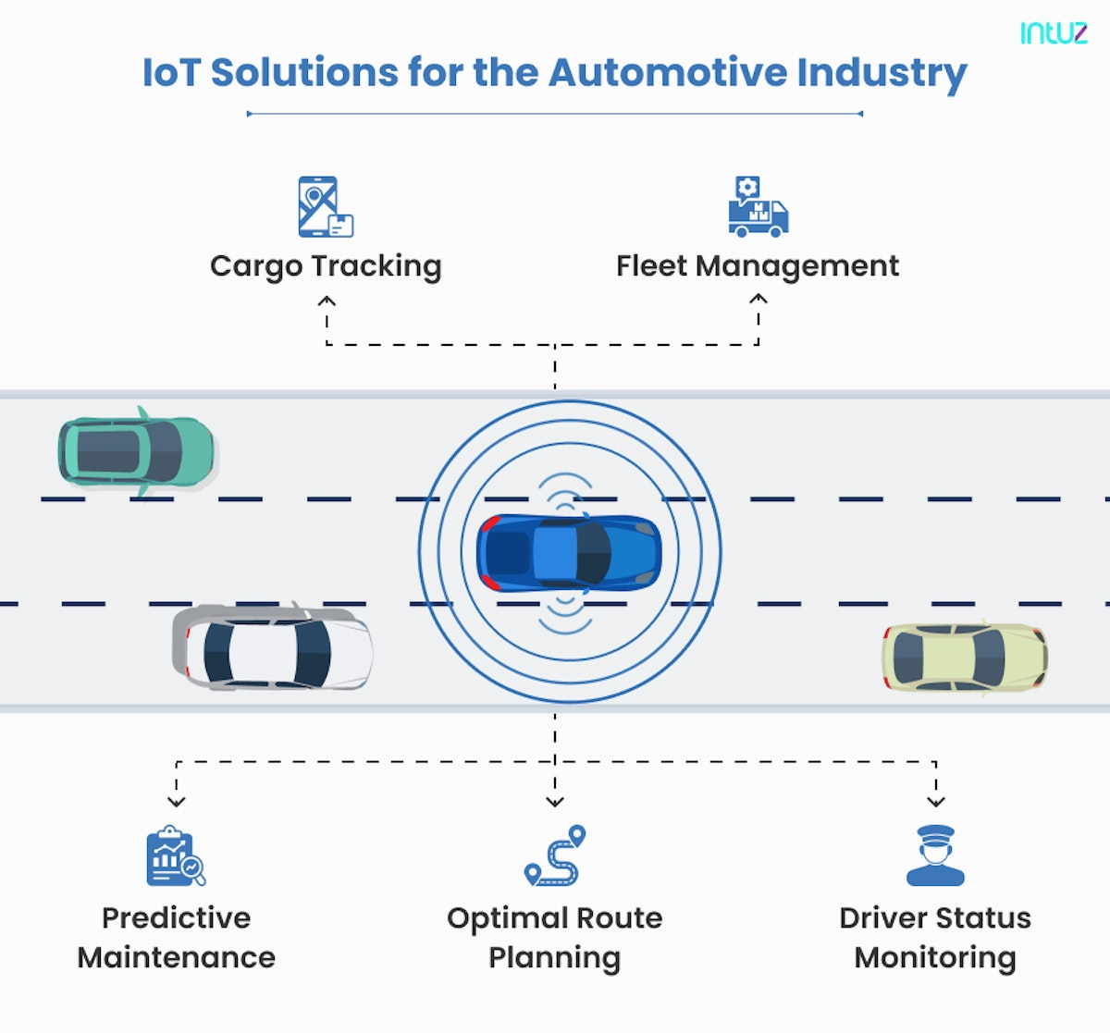
What industries can benefit from IoT?
Automotive
Connected vehicle systems could monitor air quality, traffic flow or even road conditions in real-time. Implementing IoT technologies can help transportation businesses profit from the following things:
Cargo tracking
Fleet management
Predictive maintenance
Optimal route planning
Driver status monitoring

Slide 24
INTEGRASI DATA

Slide 25

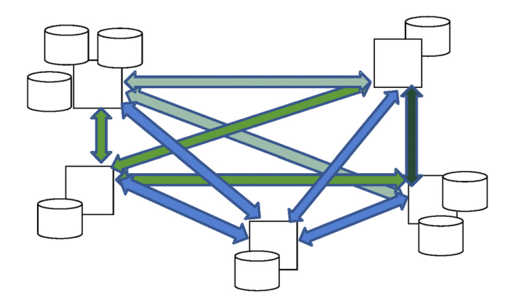
The natural complexity of data interfaces
The average corporate computing environment is comprised of hundreds or even thousands of disparate and changing computer systems that have been built, purchased, and acquired
As more systems are added to an organization’s portfolio, the number and complexity of the interfaces between the systems grow dramatically, making management of those interfaces overwhelming.
The number of interfaces between applications and systems may become an exponential factor of the number of systems.
An organization that develops interfaces without an enterprise data integration strategy can quickly find managing the vast numbers of interfaces that ensue impossible.

Slide 26
Purchased vendor packages
It has been the general consensus for years that, in most cases, except for strategically differentiating applications, it is more cost effective to purchase packages and configure appropriately for the organization
Another term for purchased package is COTS (Commercial Off the Shelf) software.

Slide 27
Data in motion
Data in motion: data that travels between systems, applications, data stores, and organizations.
“data in motion” is the central to the effectiveness of any organization
Data integration in practice:
Integrating into a common format—transforming data
Migrating data from one system to another
Moving data around the organization
Pulling information from unstructured data
……(dibicarakan lebih lanjut pada pembahasan integrasi data)

Slide 28
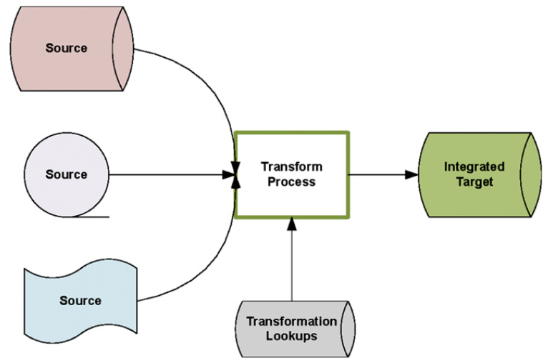
Integrating into a common format—transforming data
Usually, the most complex and difficult part of integrating data is transforming data into a common format.

Slide 29
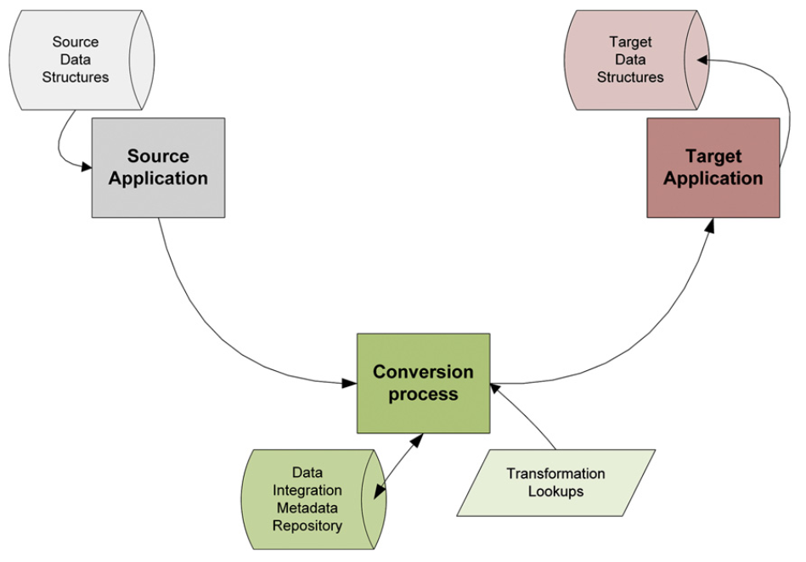
Migrating data from one system to another
When an application in an organization is replaced, either by a new custom application or by a purchased package, data from the old system needs to be migrated to the new application.

Slide 30
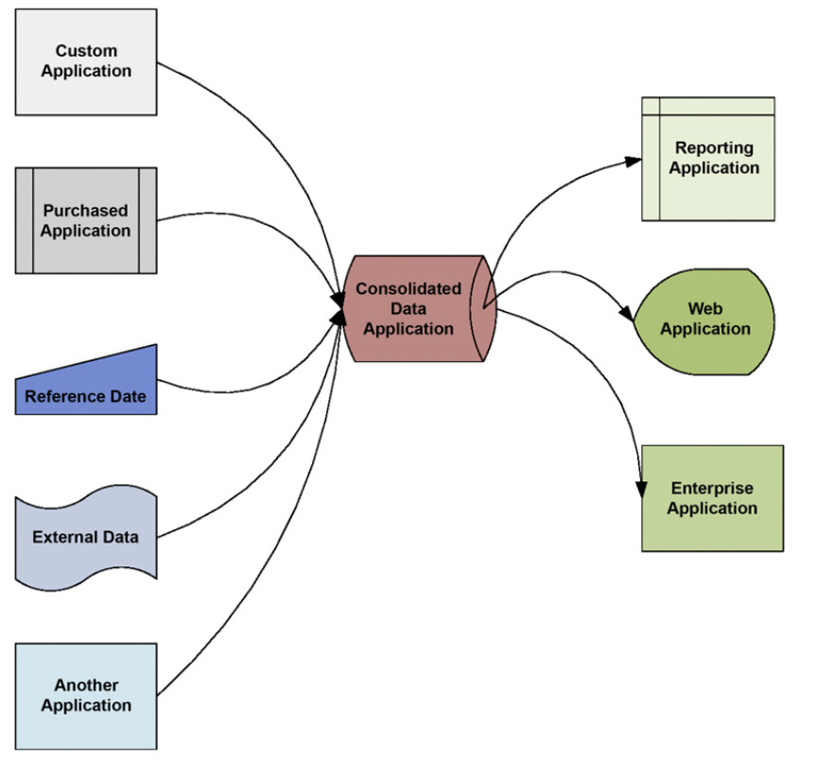
Moving data around the organization
it is critical to the organization that the applications in an organization can share information between them.
Independent, stand-alone applications that do not share data with the rest of the organization are becoming less and less useful.

Slide 31
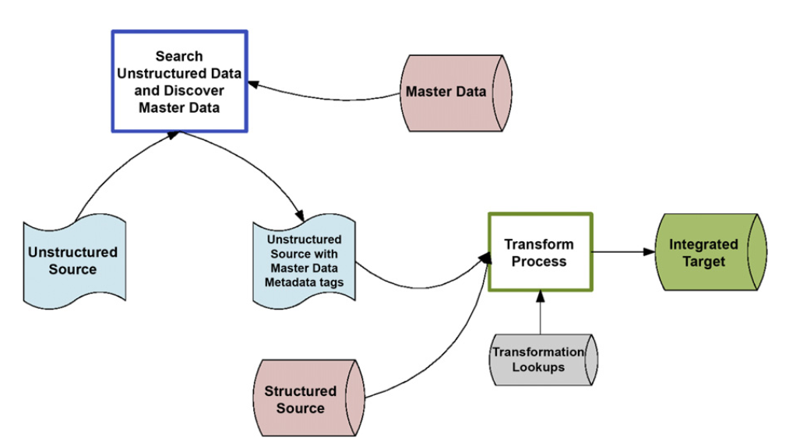
Pulling information from unstructured data
Now, it is imperative that organizations integrate their database (or structured) data with data in documents, e-mail, websites, social media, audio, and video files
The common term for data outside of databases is unstructured
data.

